Slide 1

DAUGAVPILS preschool Nr 27
“My ladybird”
Latvia

Slide 2
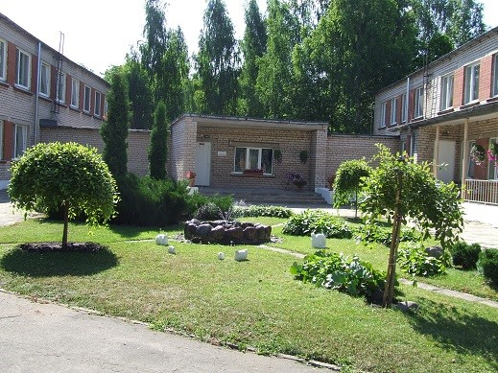
Our preschool was founded in 1973

Slide 3
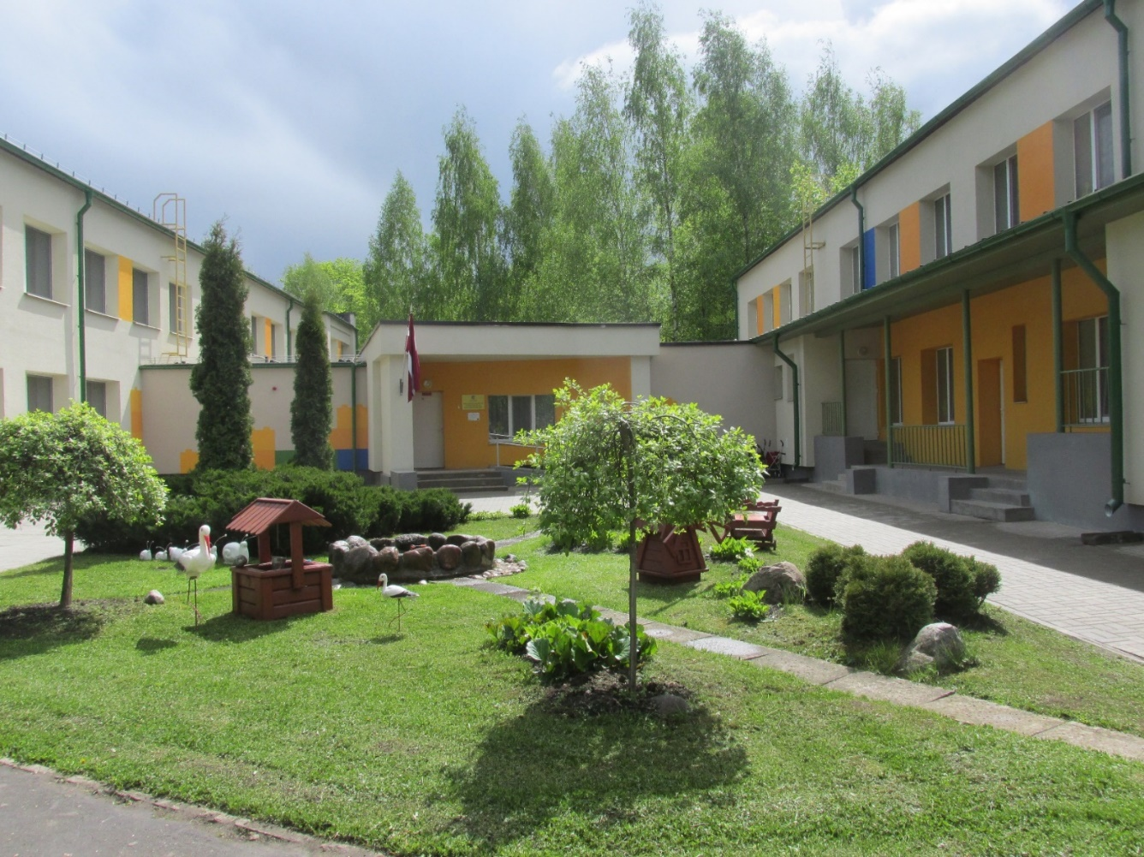
In 2014, the project of increasing the energy efficiency of the institution was implemented - the preschool was renovated

Slide 4
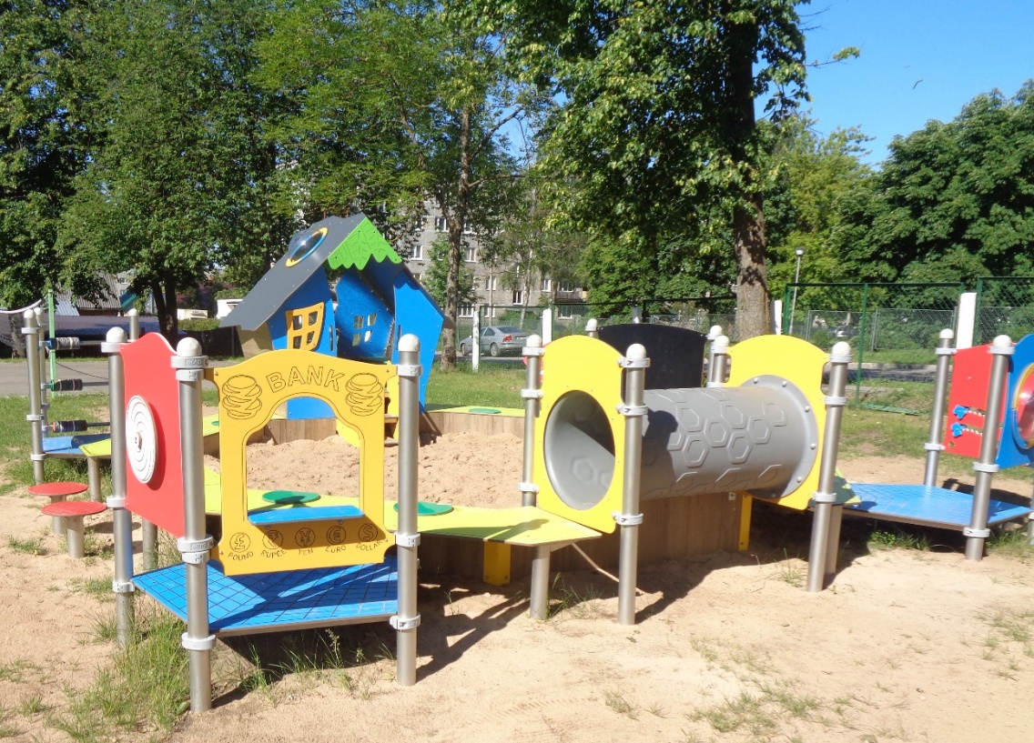
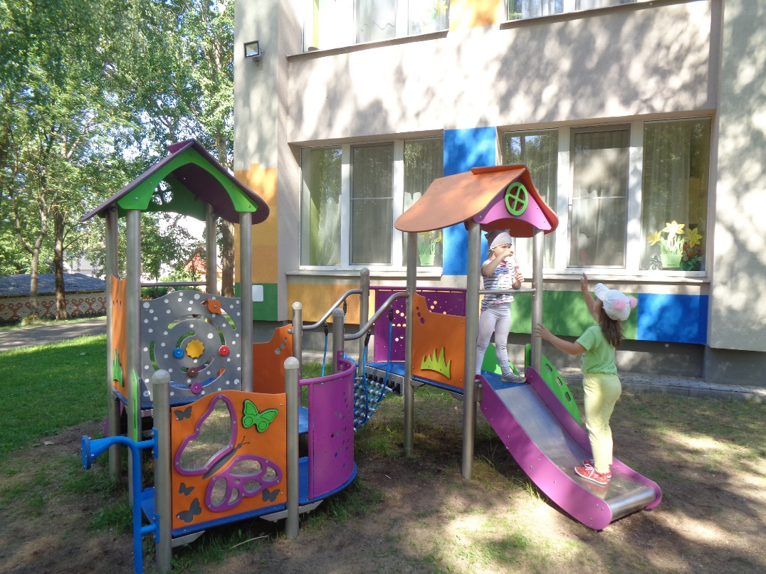
In 2019, children's playground was installed on the territory of the preschool

Slide 5
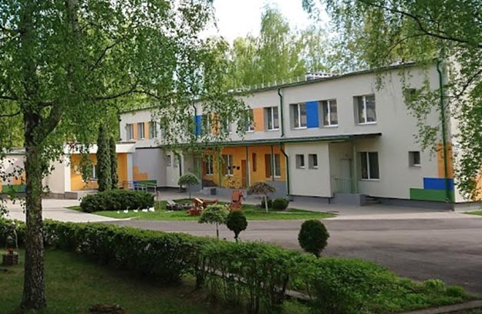
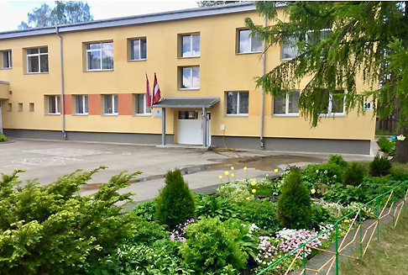

Consolidation of preschools 2023./2024
Daugavpils 27.PII
Daugavpils 22.PII

Slide 6
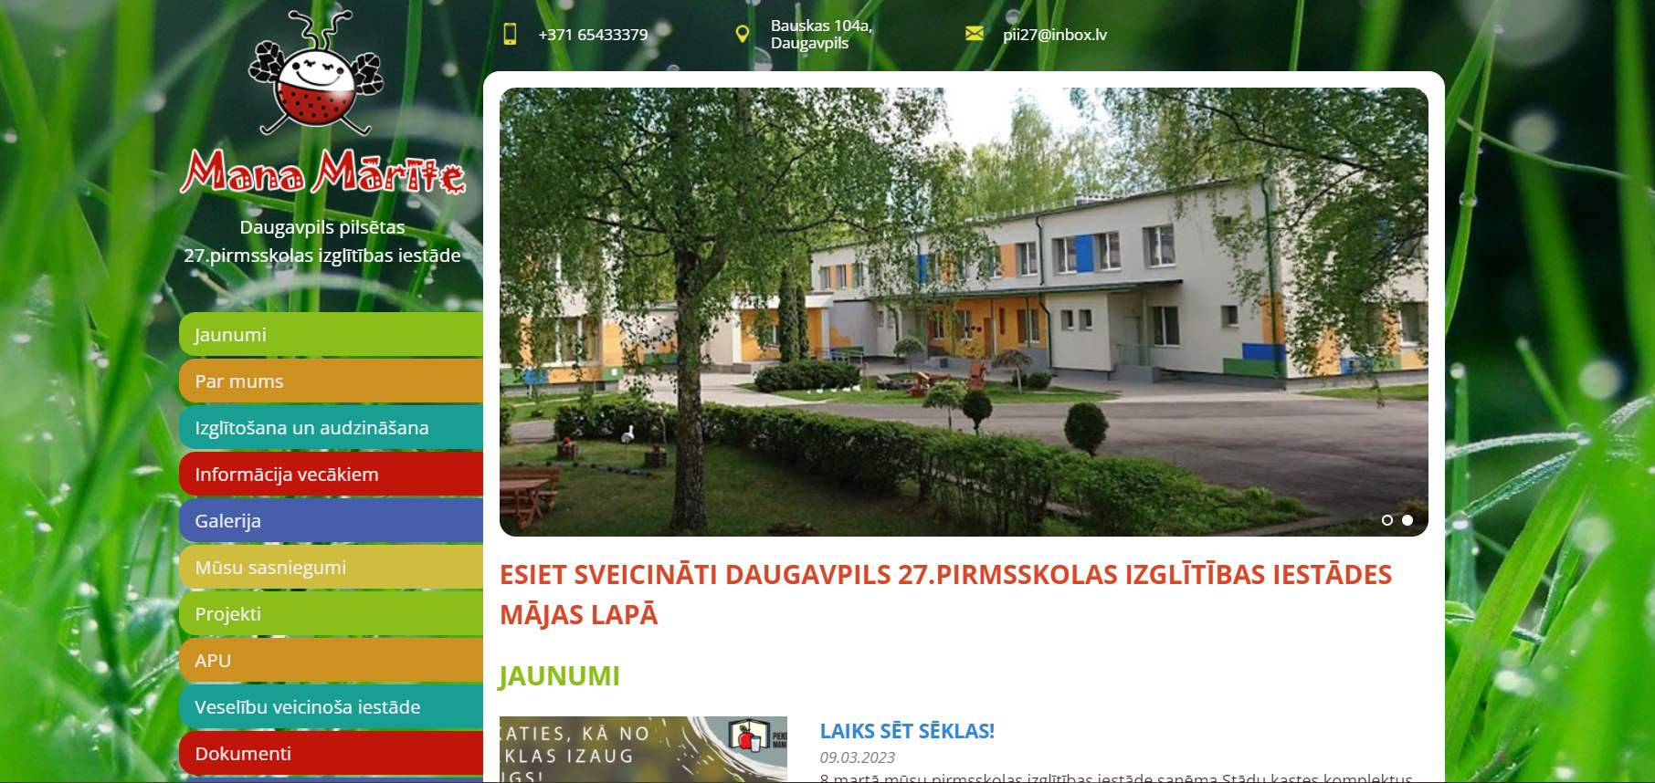
Preschool webpage www.manamarite.lv

Slide 7
Daugavpils 27th preschool implements programs:
General preschool education program
( code 01011111) – 13 groups
Special preschool education program for students with language disorders, (code 01015511) and Special preschool education program for students with mixed developmental delays (code 01015611) – 1 group
- 256 children play, acquire knowledge, improve their language and various skills in our preschool
-Number of groups -14
-The children in the institution are cared for by 60 staff members, of which 30 are teachers.

Slide 8
Interest education
Dance studio
English «Happy hearts»
Karate
Educational interest group "Fundamentals of ice skating and ice hockey"

Slide 9
MANAGEMENT MODEL IN DAUGAVPILS 27. PRE-SCHOOL EDUCATIONAL INSTITUTION
PRESCHOOL TEAM
PRESCHOOL TEAM
STAFF
TEACHERS
Management team
PRESCHOOL TEAM
PRESCHOOL TEAM
DIRECTOR
SPEECH THERAPISTS
EDUCATIONAL TECHNOLOGY MENTORS
-DEPUTY OF DIRECTOR
- MANAGER
-NURSE
-SECRETARY
TEACHERS
PRESCHOOL TEAM

Slide 10
Preschool’s vision and mission
Vision: a preschooler is a curious, creative, comprehensively developed personality who is interested and motivated to learn, observe, explore the world, recognize emotions, control and manage his behavior.
Mission: to support every child's inner desire to learn about the world around them, to create a creative, safe, healthy, positive play and learning environment for the multifaceted development of every child.

Slide 11

Preschool values
HEALTH
TEEM WORK
RESPECT AND SUPPORT
EMOTIONAL WELL-BEING

Slide 12
Preschool’s priorities
Priorities of preschool work in the 2024/2025 school year:
Transition to a unified school
A digitally competent educational institution

Slide 13
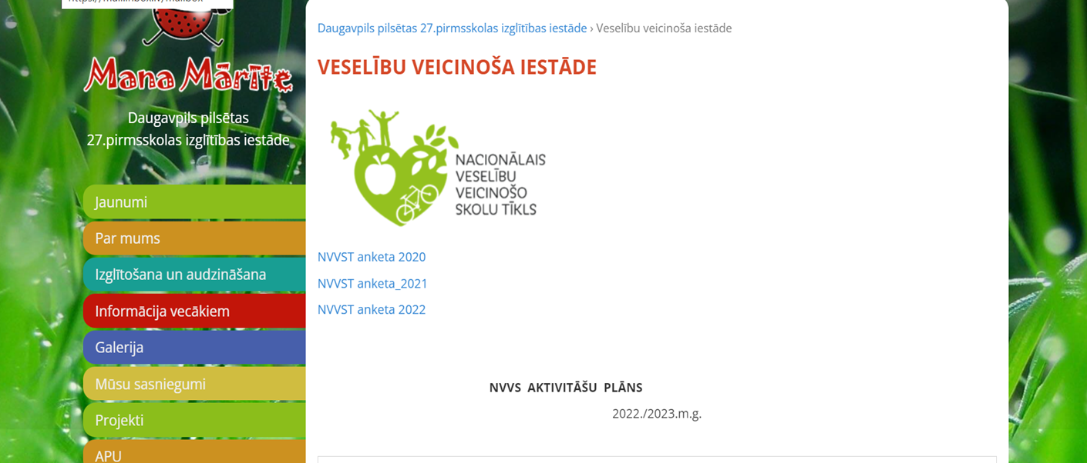
In 2016, the status of "Health-promoting institution" was granted

Slide 14
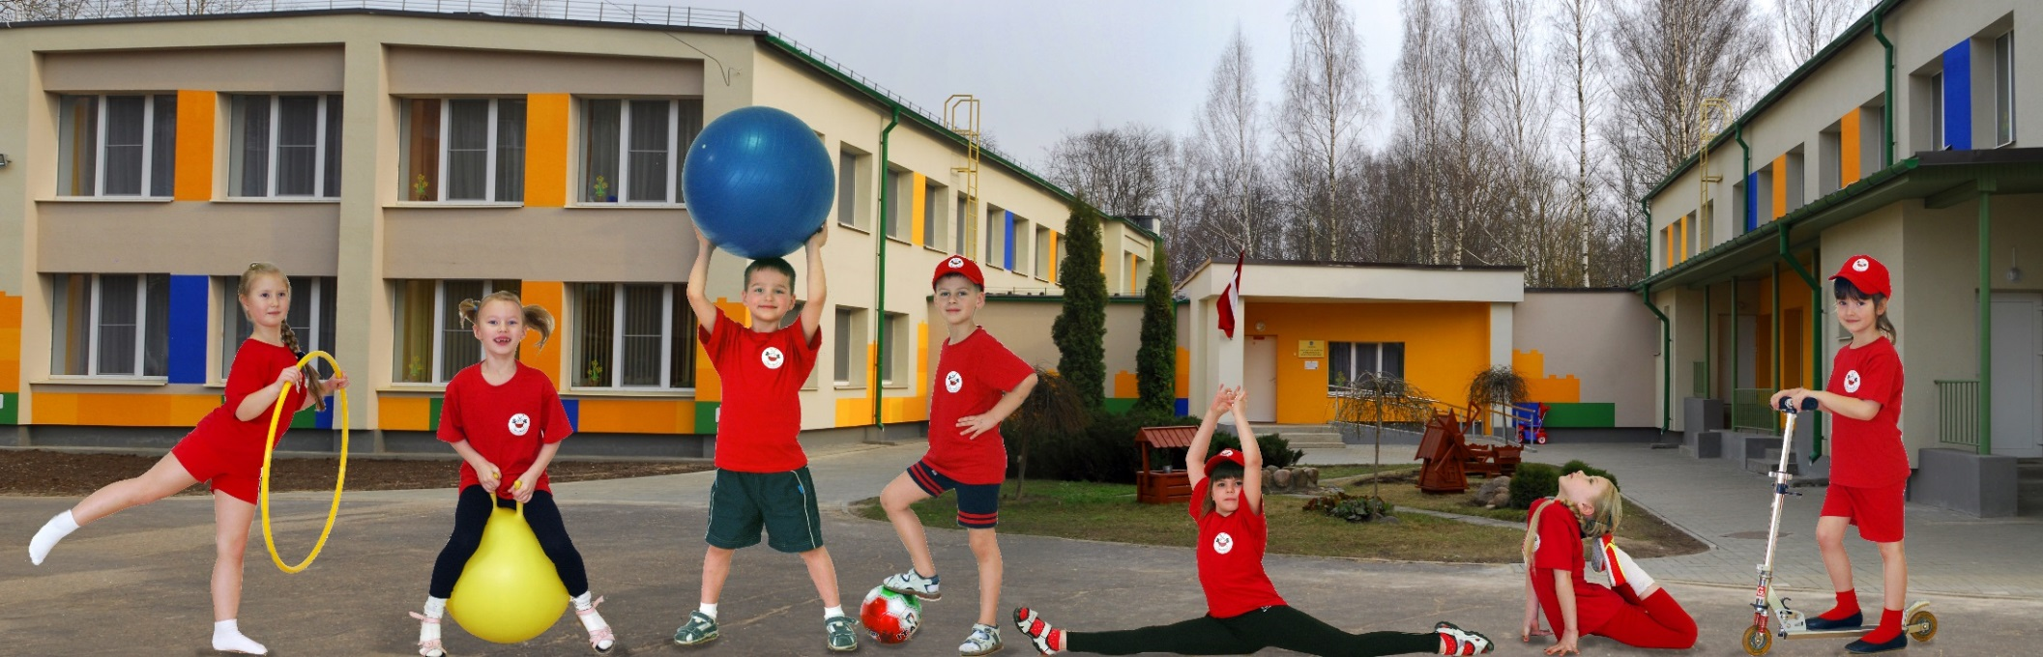
COMPLEX OF HEALTH PROMOTING EVENTS
-Activities for students
-Activities for parents of students
- Activities for employees of the preschool

Slide 15
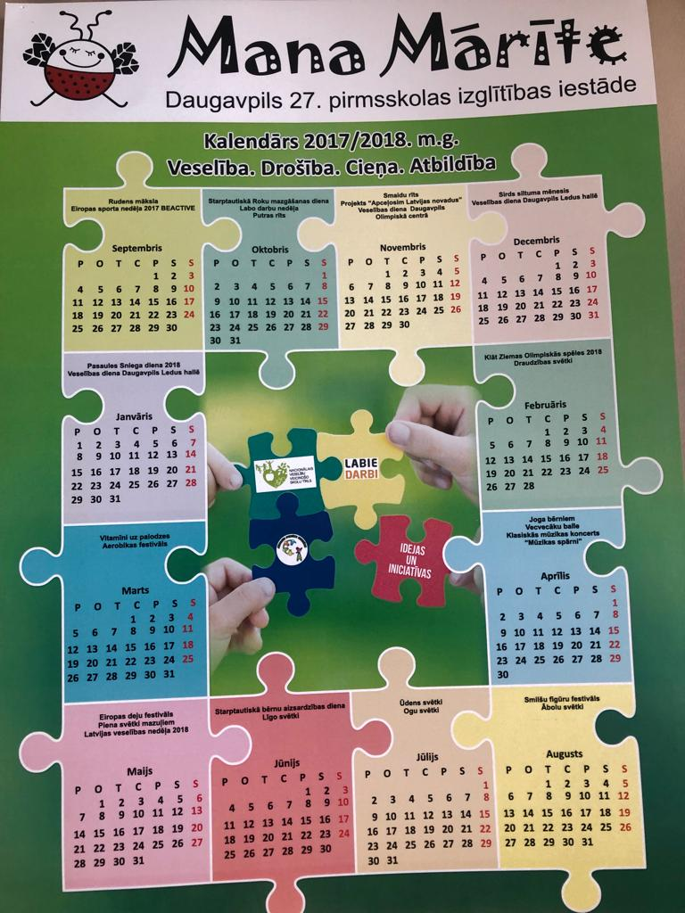

From 2017 preschool implements the PBS program (POSITIVE BEHAVIOUR SUPPORT)

Slide 16
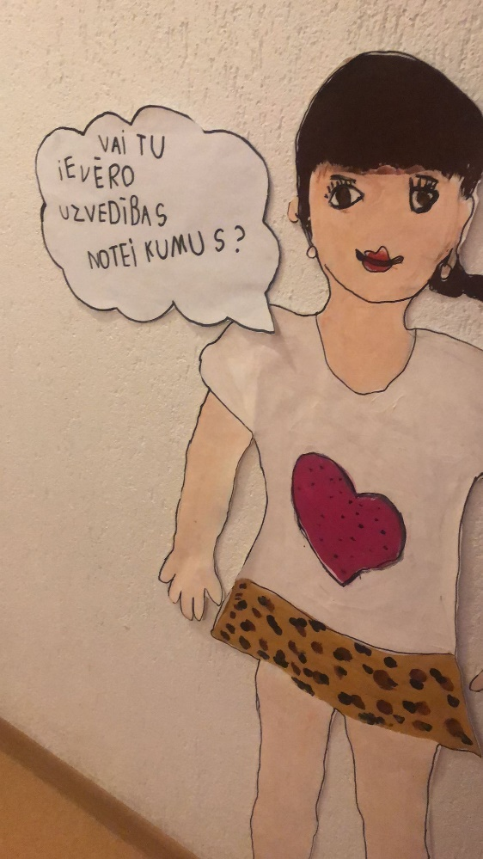
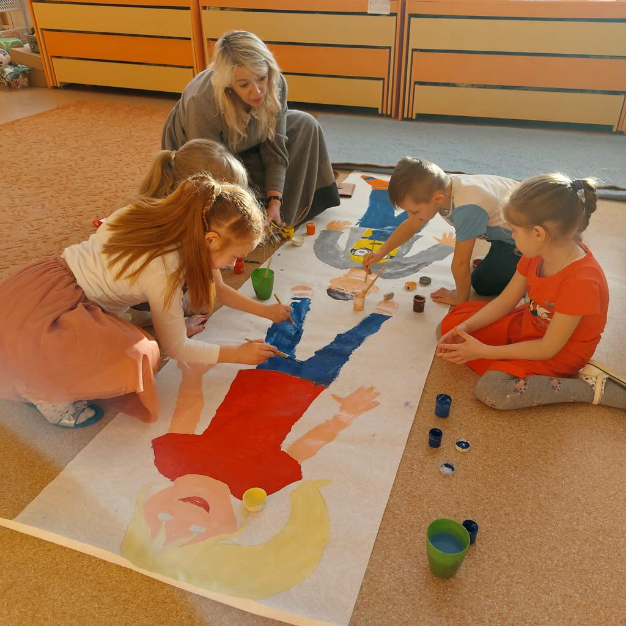
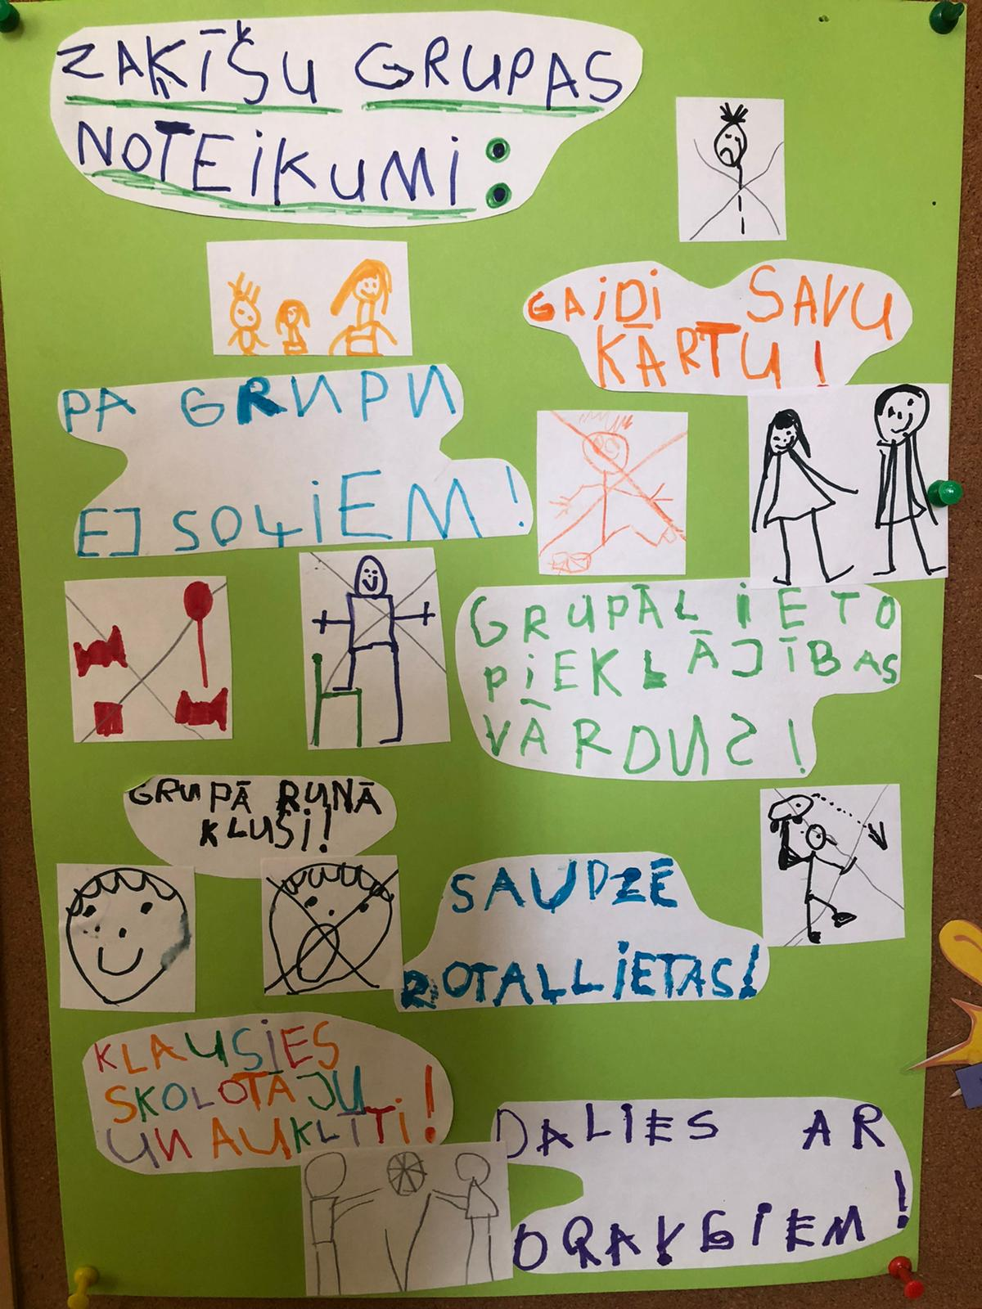
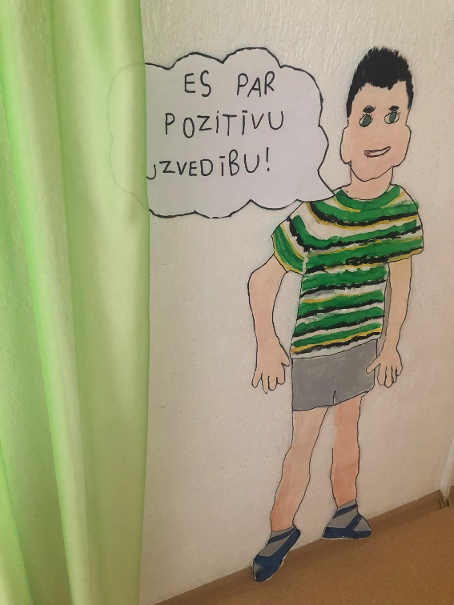
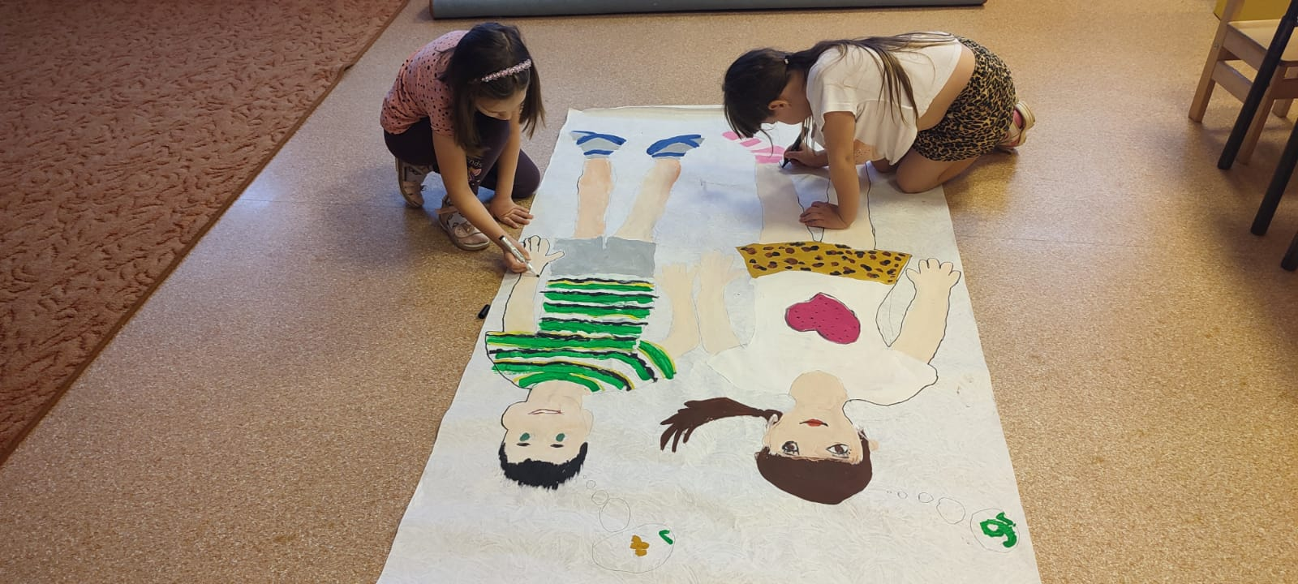

Slide 17
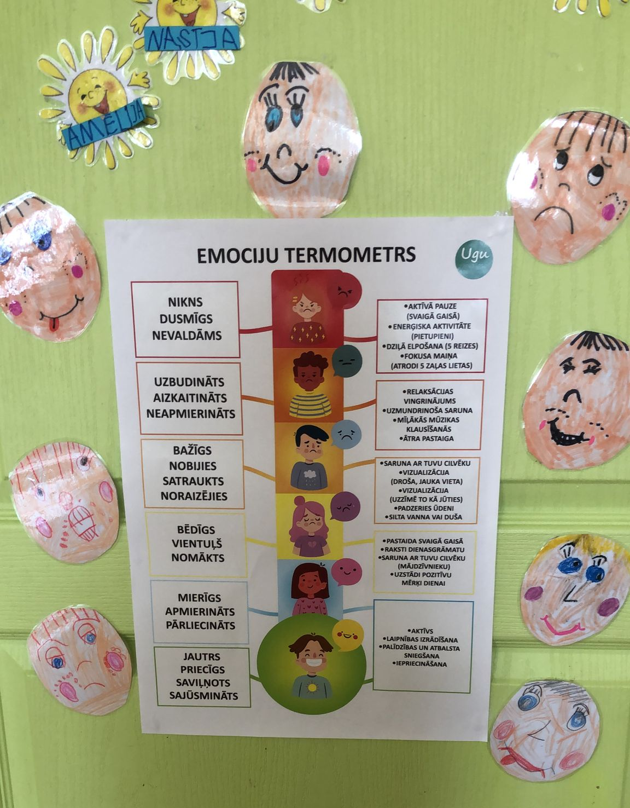
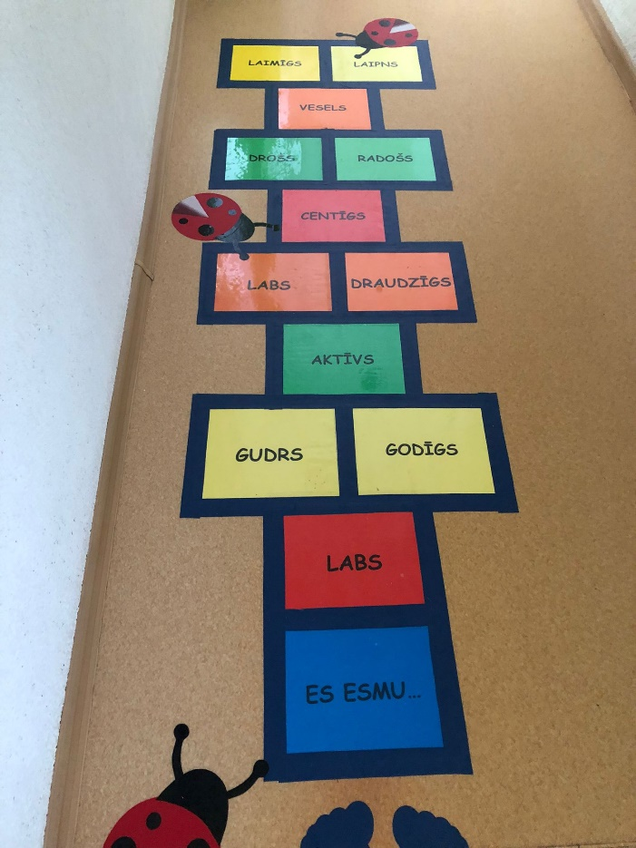
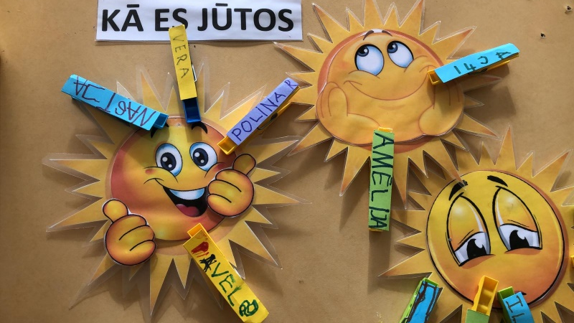
Implementation of the SEM program in 2022/2023
SOCIAL-EMOTIONAL TRAINING

Slide 18
Collaboration partners
Library
Daugavpils Clay Art Center
Daugavpils Local History and Art Museum
Daugavpils Innovation Center
Daugavpils day center «Saskarsme» LMSA - Latvian Multiple Sclerosis Association
Charity foundation «Trust Fund»
Daugavpils Technological High School-lyceum
Latgales ZOO

Slide 19



Participation in Erasmus+ projects
2018-2021 Erasmus+ project "DEveloping innovative learning contexts in pre-scHools’ OutdooR Spaces" DEHORS
2020-2022 Erasmus+ project “Quality in Early Childhood Education” Digital tolls for learning QUED
2022-2024 Erasmus+ project ”Improving preschool teachers’ skills in outdoor education” ORE

Slide 20


Project DEHORS outputs
Guide for the development and valorization of outdoor spaces
1. Guides
2. Booklet Practices
3. Online Training module on outdoor activities for teachers based on the content of the guide https://elearning.dehors-project.eu/

Slide 21
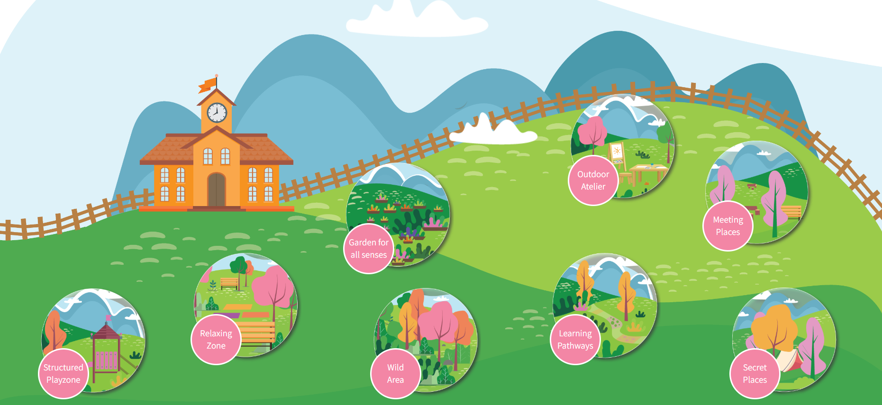
INTERACTIVE MAP

Slide 22
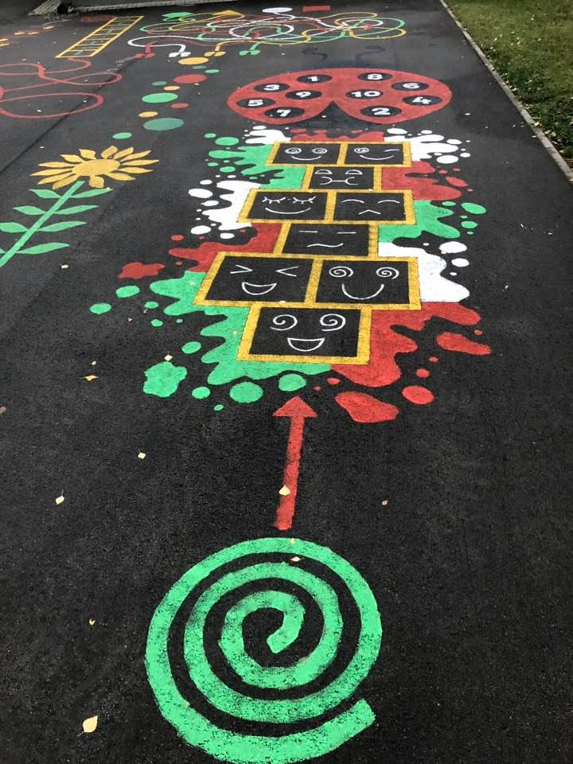
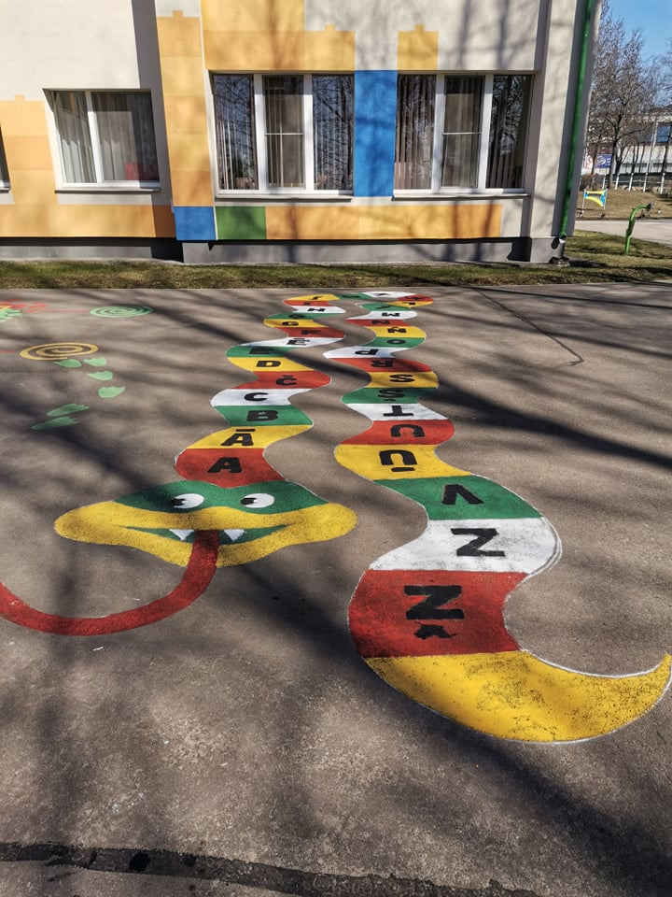
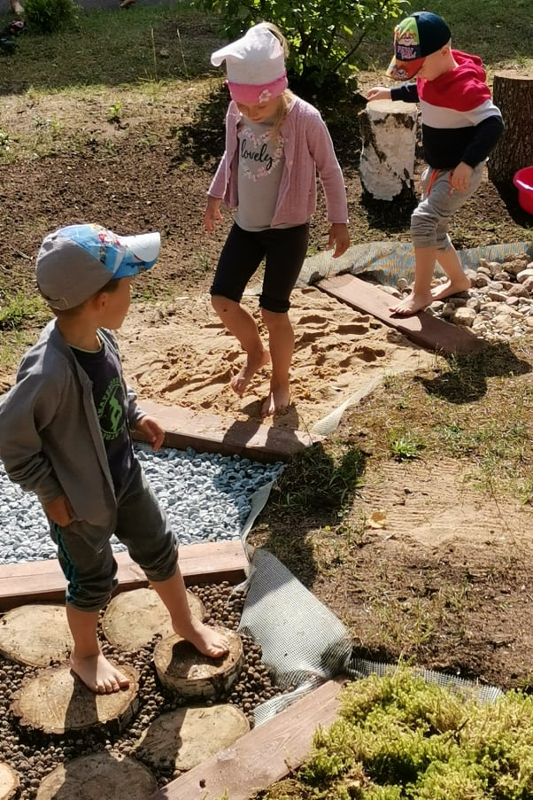
LEARNING PATHWAYS

Slide 23
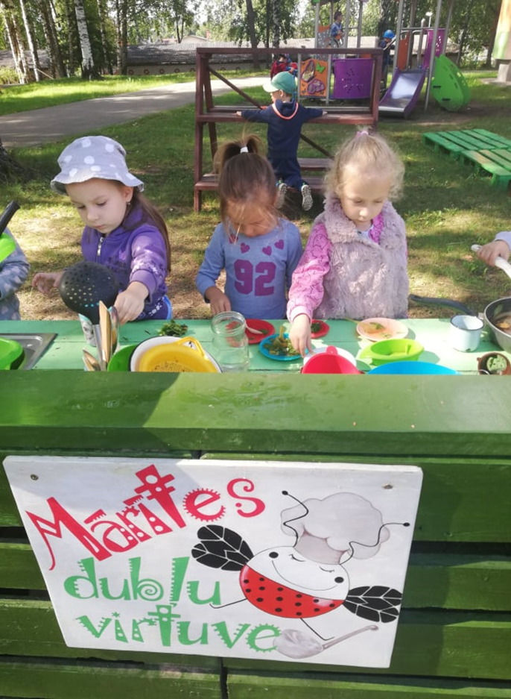
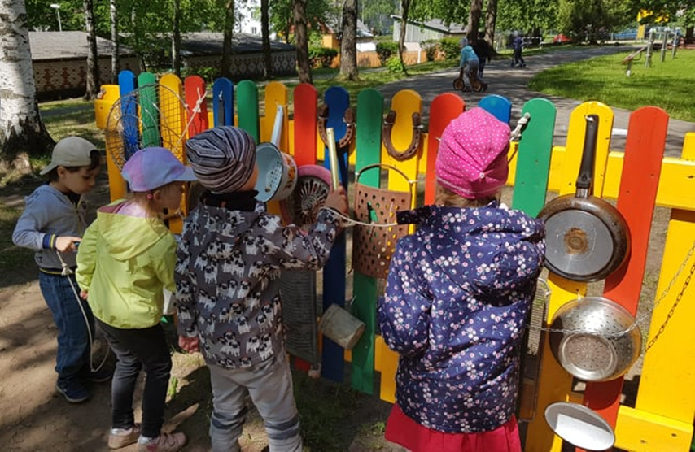
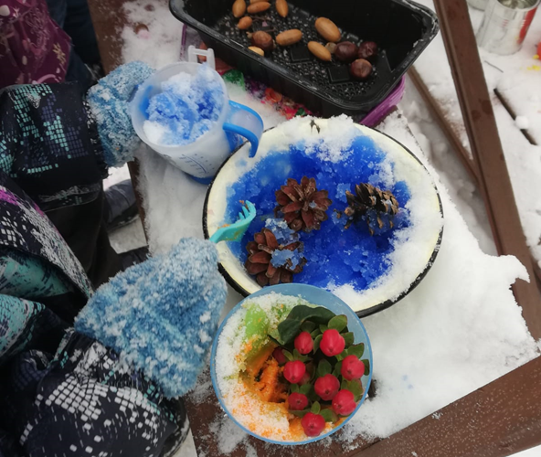
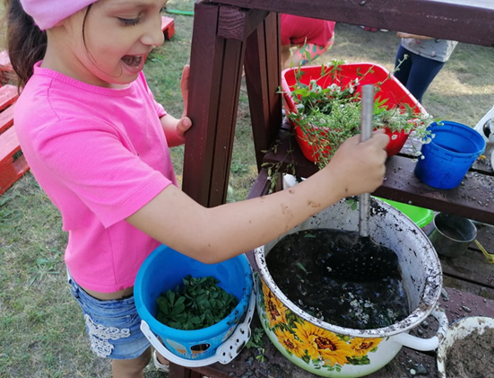
MUD KITCHEN AND MUSICAL WALL

Slide 24

Project QUED outputs
Improved digital skills of educators and learners
Digital tools for learners
Meaningful use of digital technologies in the learning process

Slide 25
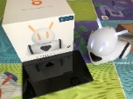
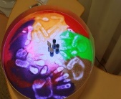
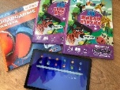
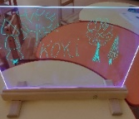
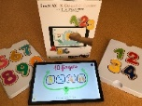
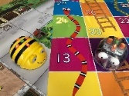
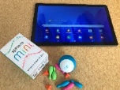
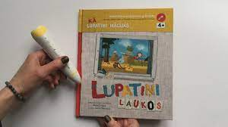
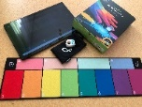
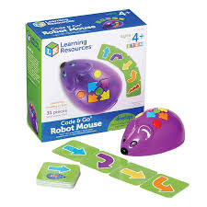
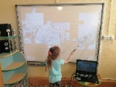
Digital tools available at Daugavpils 27th preschool
SCREEN DIGITAL TOOLS:
PHOTON ROBOTS
LIVE ABC 3D
MARBOTIC NUMBERS AND
LETTERS
SPHERO MINI
SPHERO SPECDRUMS
Interactive whiteboard,
screen, tablets, cameras
SCREEN-FREE DIGITAL TOOLS:
LIGHT TABLE
LIGHT ESSEL
BEE-BOT ROBOT
TALKING PEN
ROBOT MOUSE

Slide 26
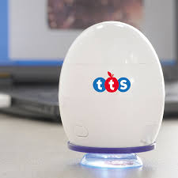
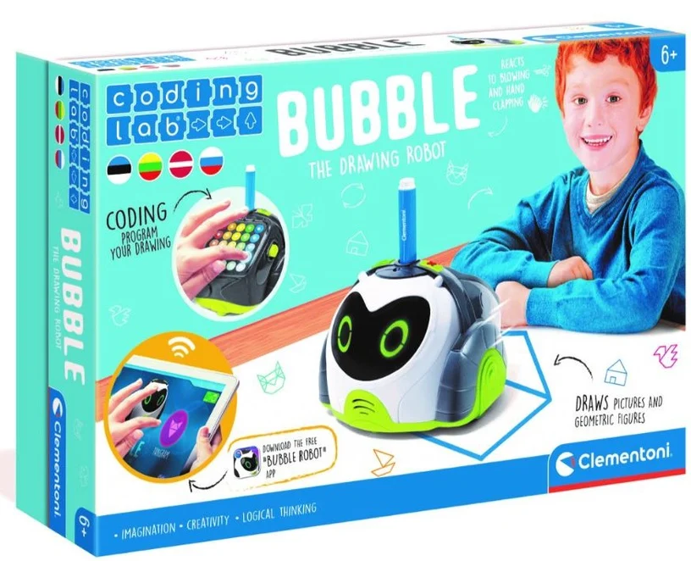
Digital tools available at Daugavpils 27th preschool
Easi-Scope Microscope
Bubble Drawing Robot

Slide 27
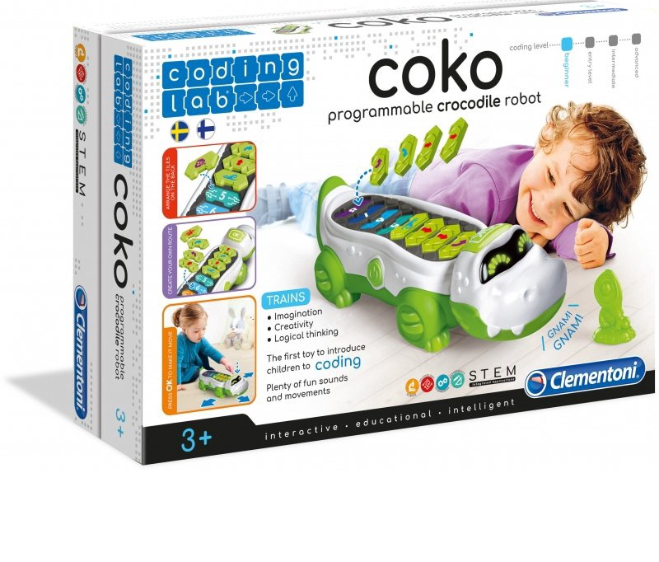
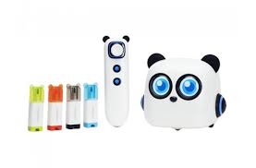
Digital tools available at Daugavpils 27th preschool
Crocodile Coko robot
Makeblock mTiny Atklājēja komplekts

Slide 28
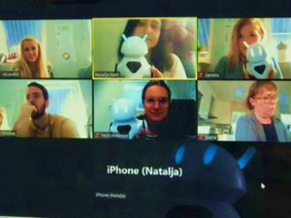
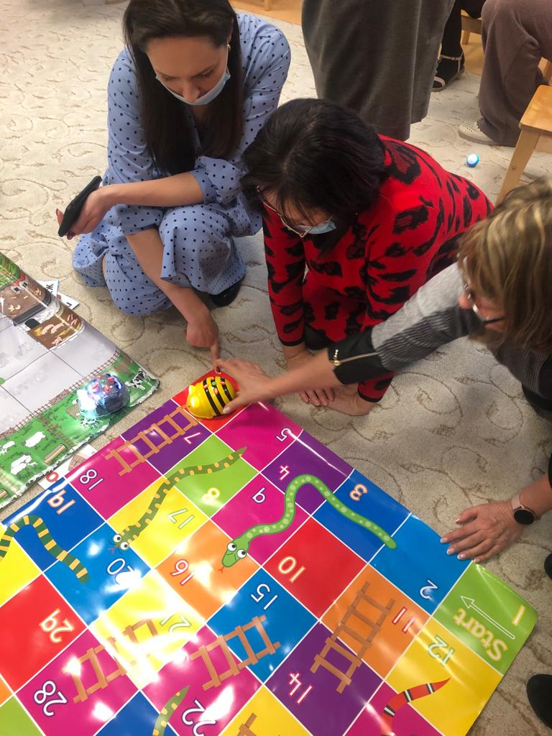
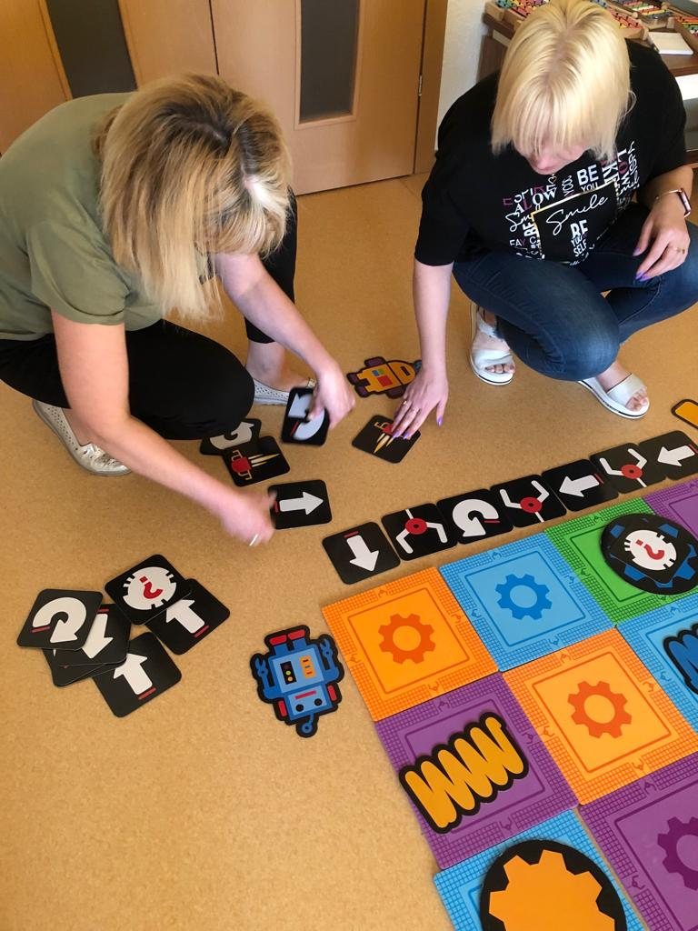
Pedagogical training in digital technology workshops and during meetings of project partners

Slide 29
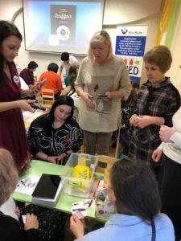
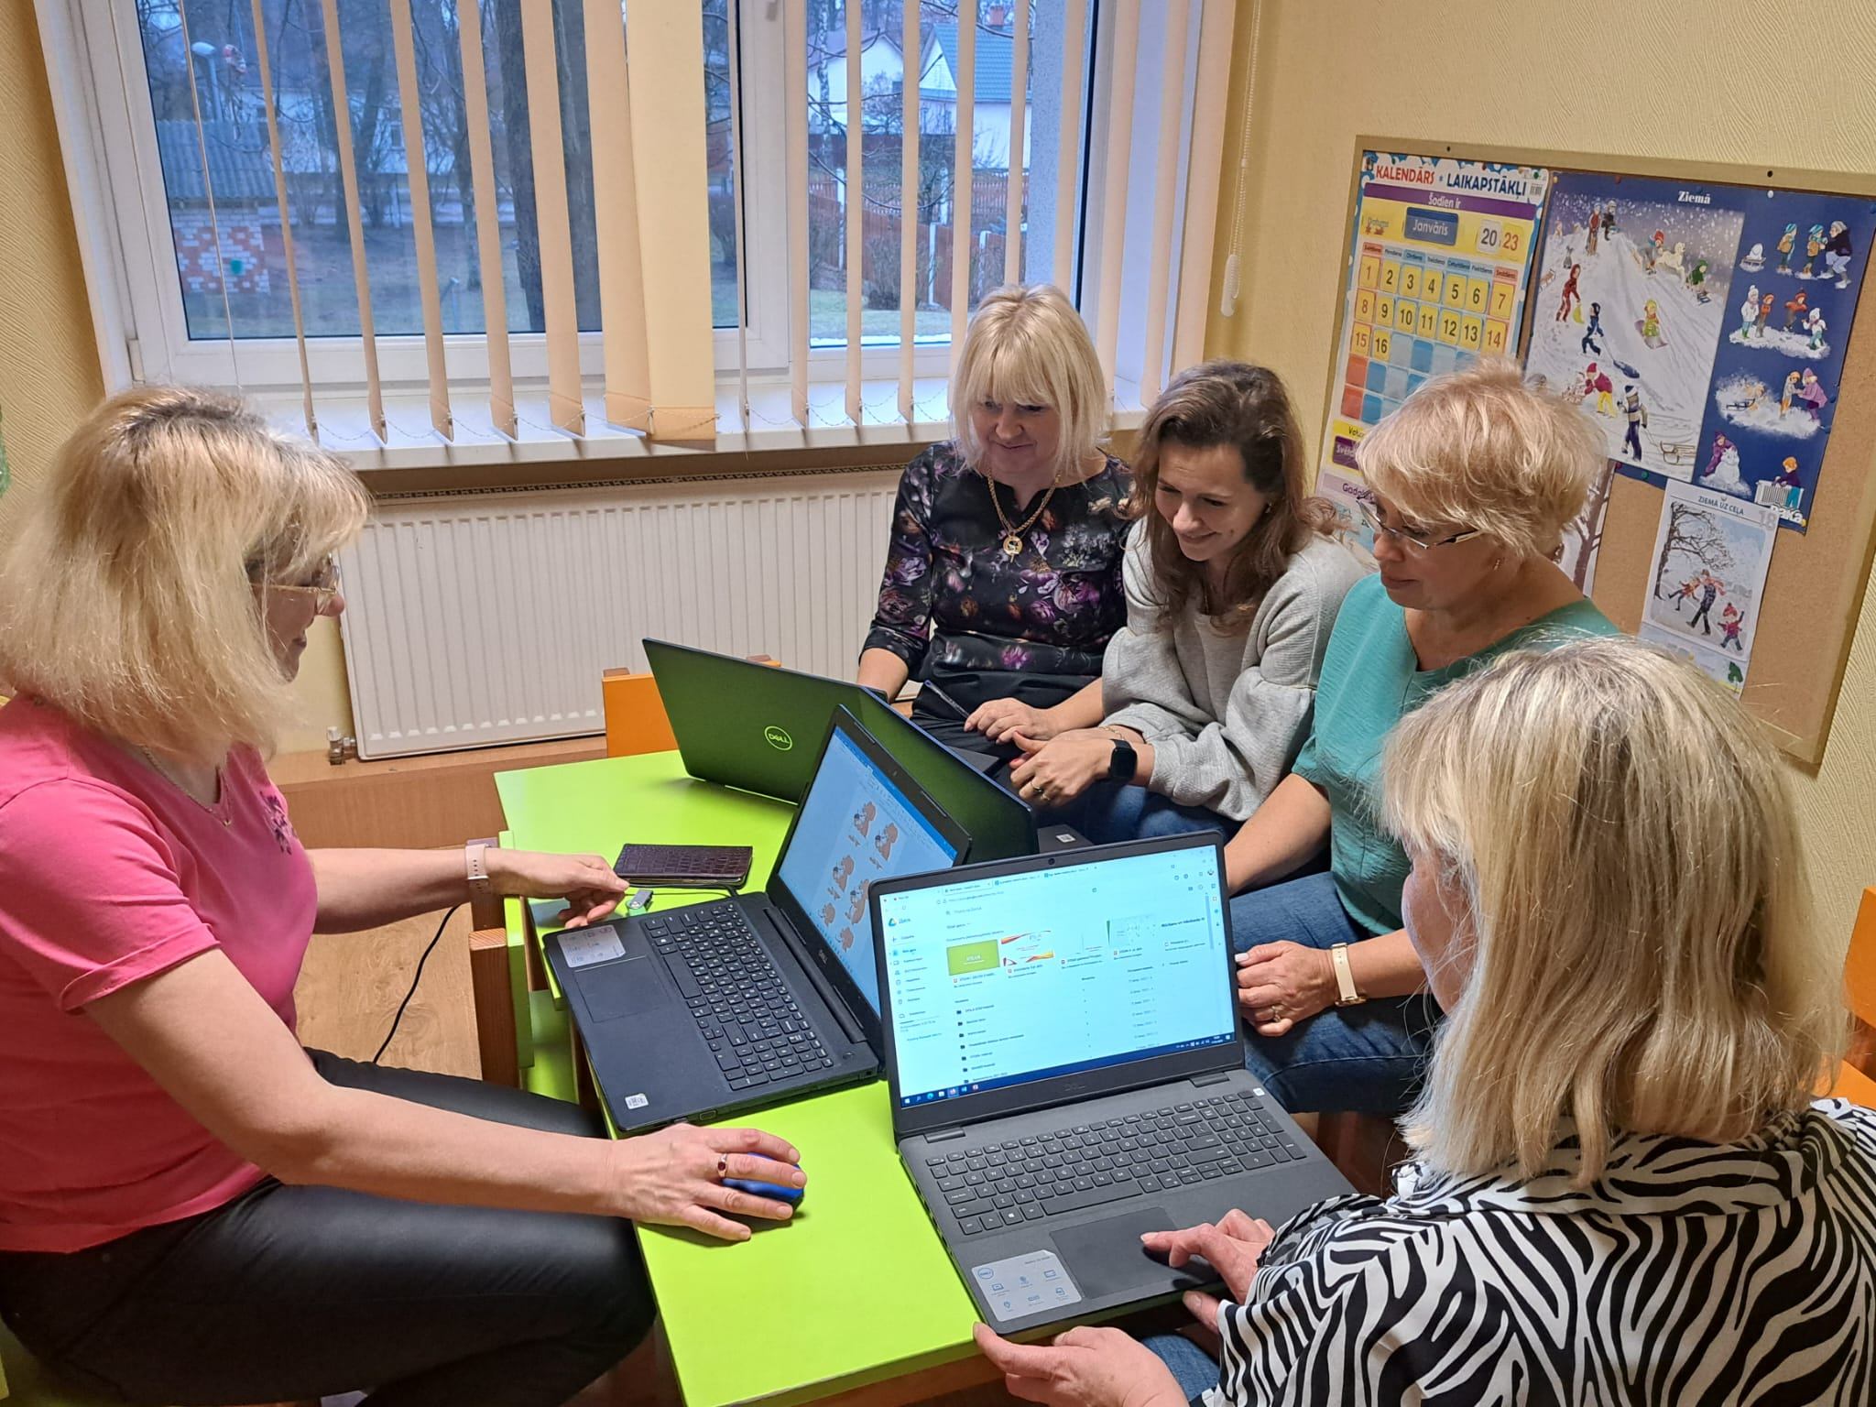
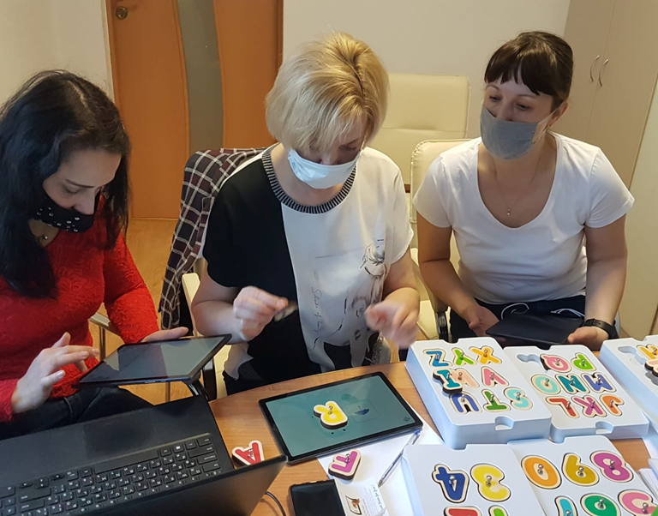
Professional support available to educators
An educational technology mentor in our institution is a teacher educator who plans and implements lessons, experiments with the use of technology in the learning process and supports the adoption of "good practices" in the institution to ensure the digitization process, teacher readiness and children's acquisition of digital skills.
Educators in a mutual learning institution

Slide 30

ORE project outputs
-Improved teachers skills in creating and organizing a safe outdoor environment in preschool educational institutions by exchanging examples of good practice.
Mutual understanding and knowledge about the work of a teacher in the field of outdoor learning and outdoor education.
-The new learning area was created outdoor – «Digging area»

Slide 31
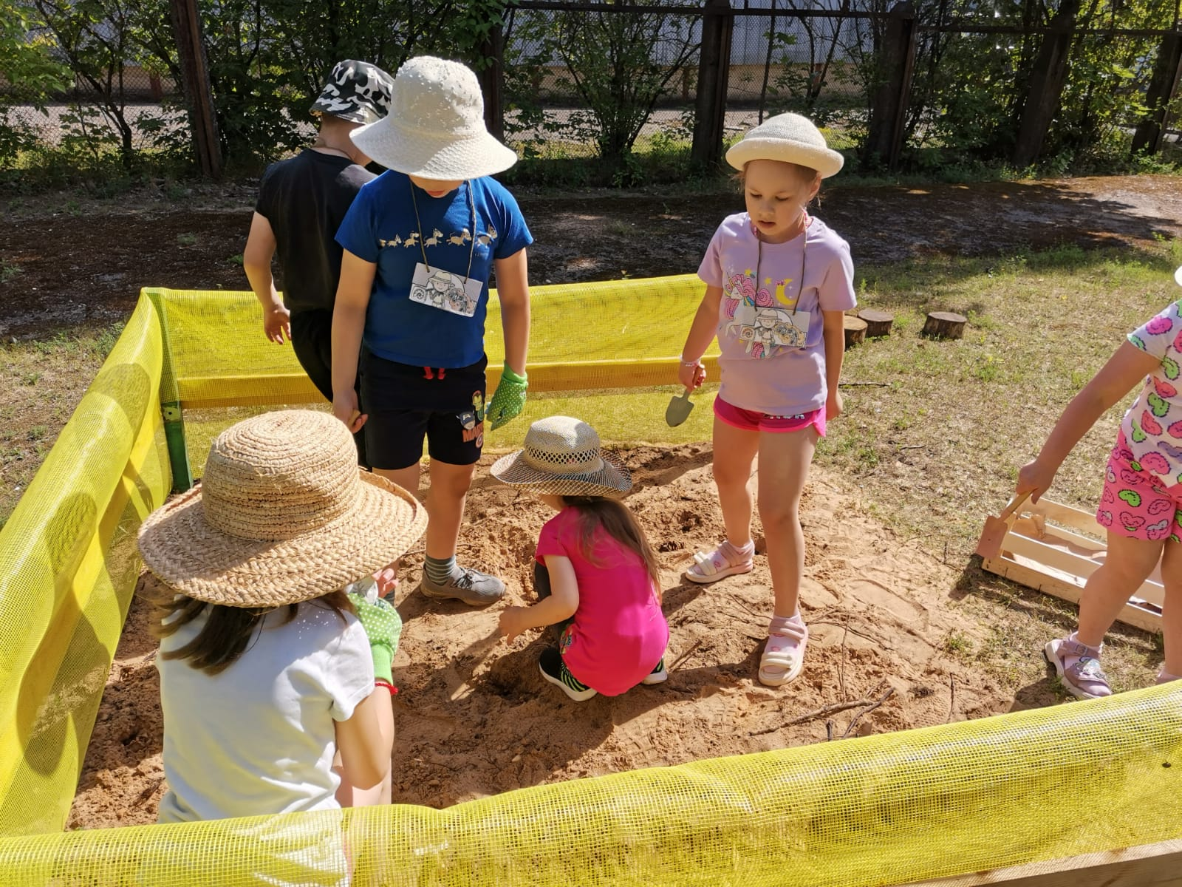
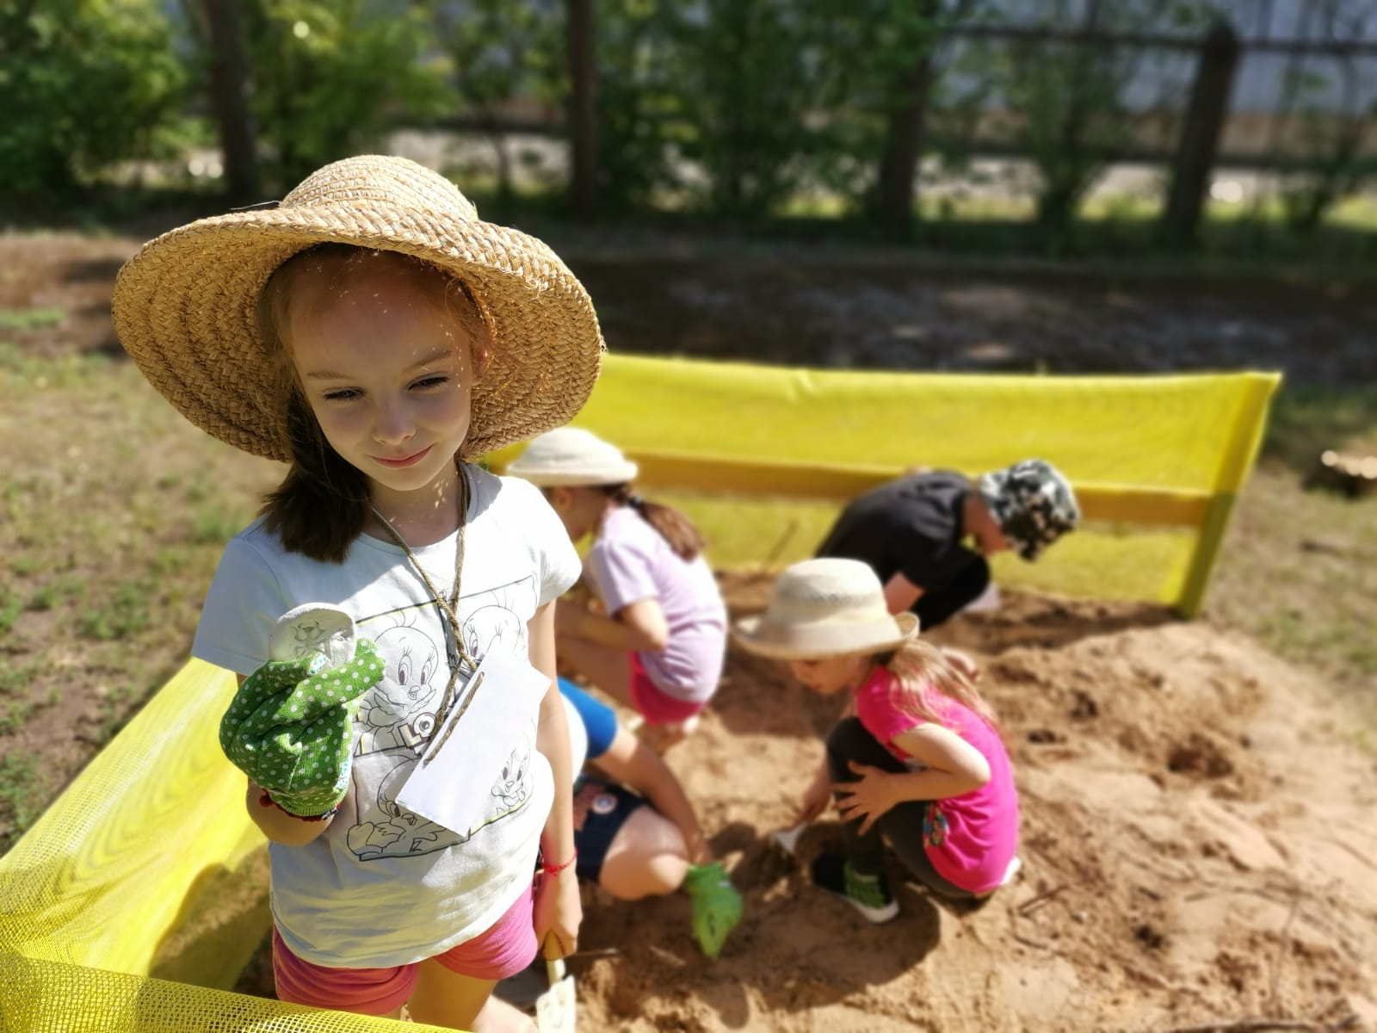
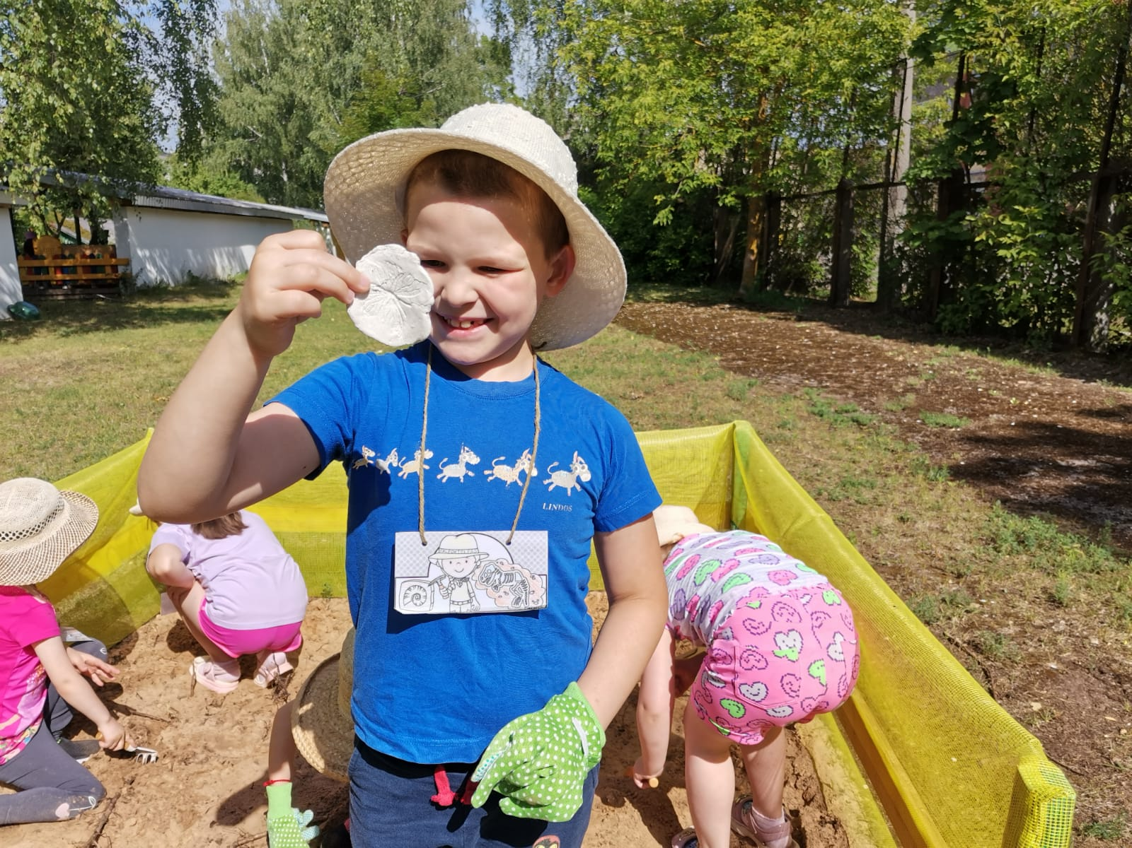


The first findings are very pleasing

Slide 32

How does goal setting work in our preschool? Priorities are reflected in the school year calendar

Slide 33


Slide 34


Slide 35



Slide 36





INTEGRATION OF THE STEAM APPROACH IN THE LEARNING PROCESS. STEAM DAY

Slide 37



Slide 38

OUR CHILDREN:
-Think like scientists
-Use useful modern technologies
-Build as an engineer
-Paint like artists
-Solve like a mathematician
-Play like children

Slide 39

Thank you for attention!

